Slide 1
Project Tools
What to use to talk with a database

Slide 2
In this video…
We'll be learning…
The difference between a database and a client
We'll be installing…
MySQL
Database
Command Line Interface (CLI) - Client
MySQL Workbench
DBeaver Community Edition - Client

Slide 3
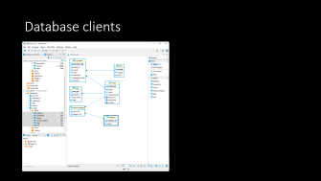
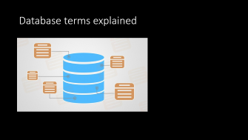
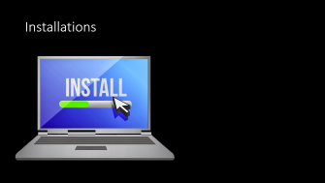
What's ahead…

Slide 4
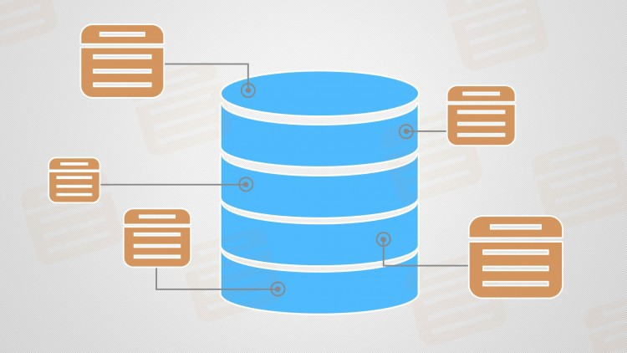
Database terms explained

Slide 5




What is a database?
An application that stores and serves up data
Database
Request
Command Parser
Response
Client
Data Storage
Task Scheduler

Slide 6
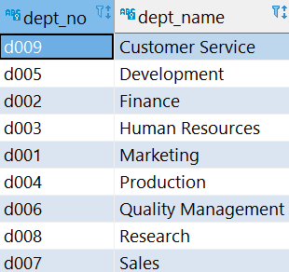
Databases contain:
Schemas, contain:
Tables (think a spreadsheet with rows and columns), contain:
Data
Database
In Database | In Java
Schema | Package
Table | Class
Row/Record | Object(instance of class)
Column | Attribute in Object
Schema
Schema
Tables
Schema
Tables
Tables
** General rule of thumb comparison

Slide 7
What is a schema?
A named collection of data within a database
A schema has a collection of tables
Tables are like spreadsheets
Tables define columns of data
Tables contain rows of data organized by column
A row and column is like a spreadsheet cell
Spreadsheet cells can have any type of data
Table rows contain data specified by the column type
Unfortunately, MySQL calls schemas databases!

Slide 8
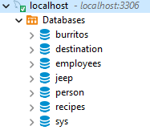
A database can have many schemas
Schemas

Slide 9
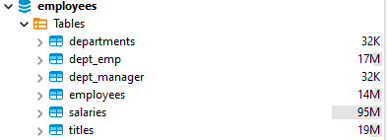
A schema can have many tables
Tables

Slide 10
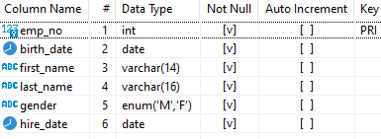
A table can have many columns (types)
Columns have a name, a type, and other attributes

Slide 11
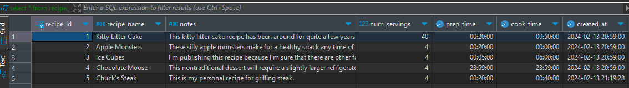
A table can have many rows (data)
In Database | In Java
Table | Class
Row/Record | Object(instance of class)
Column | Attribute in Object
** General rule of thumb comparison

Slide 12


What is a database client?
Separate application that:
Connects to a database
Sends requests to a database
Parses responses from a database
Clients are NOT databases!
Examples:
MySQL Command Line Interface (CLI)
DBeaver
Java application
Schema
Data
Database
Client

Slide 13
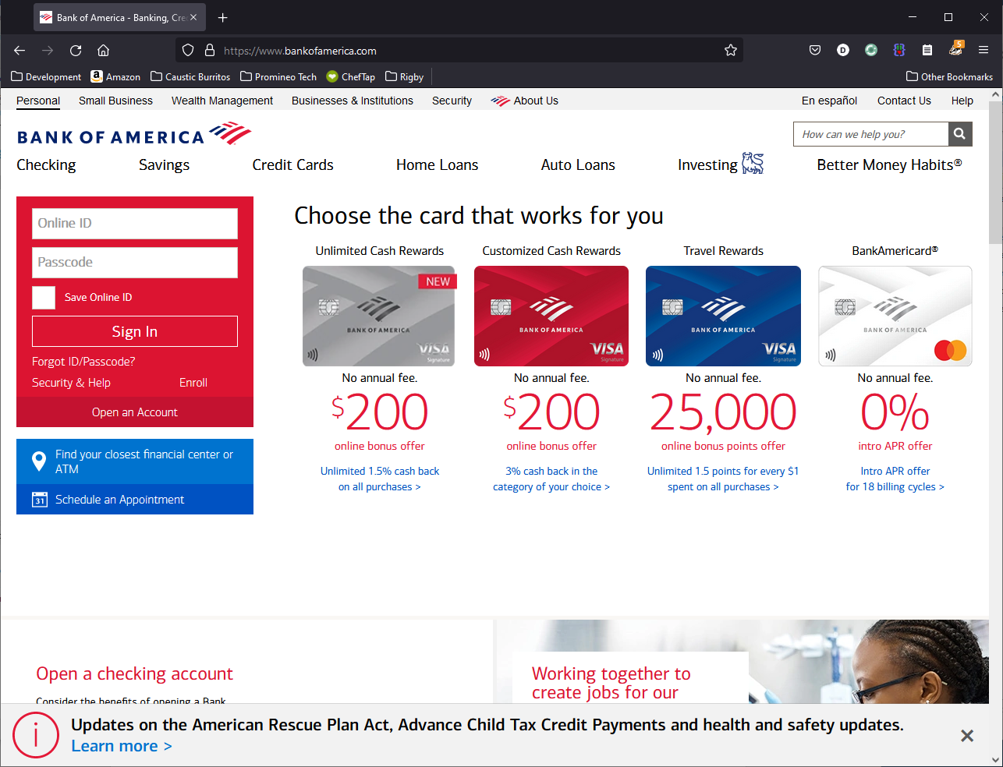
Database/client is like bank app/browser
You don’t confuse the browser with the bank application
The browser connects to the bank application

Slide 14
Database/client is like bank app/browser
Likewise, don’t confuse the database and the client
The client connects to the database
Schema
Data
Database
Client

Slide 15
Remember: a client is not a database
Database:
MySQL
Clients:
MySQL Command-Line Interface (CLI)
DBeaver
Java application

Slide 16
Connections need…
Browser to Website
Client to database
The scheme (http/https)
The host name
The port number
The locator name
https://exxon.com:8080/global_warming
The database type (mysql)
The host name
The port number
The schema name
jdbc:mysql://localhost:3306/recipes

Slide 17
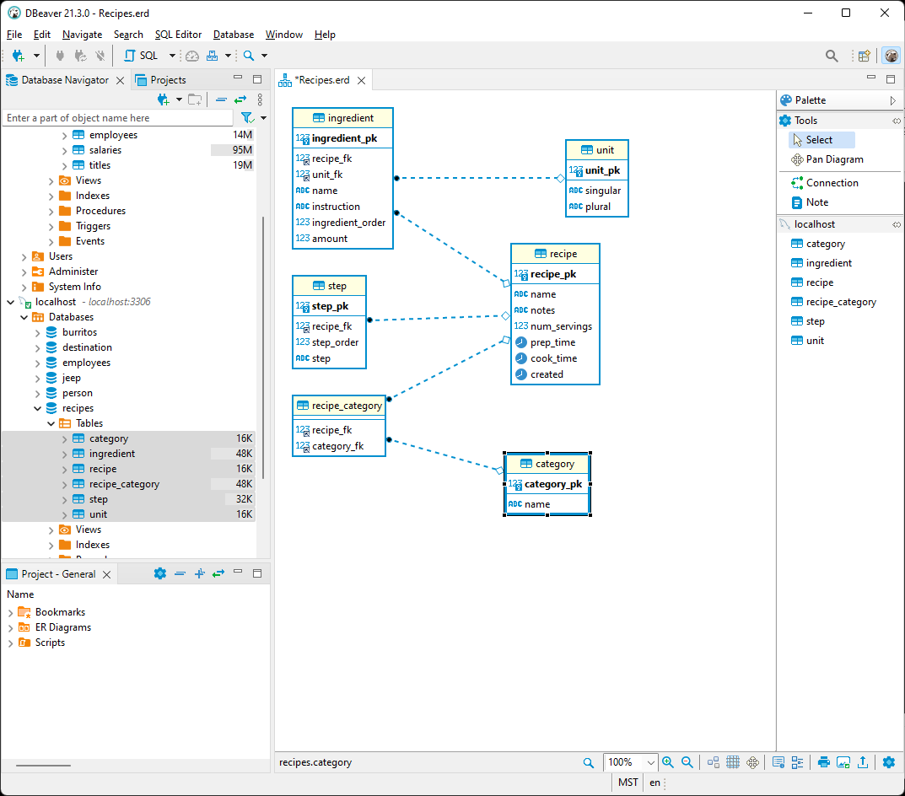
Database clients

Slide 18
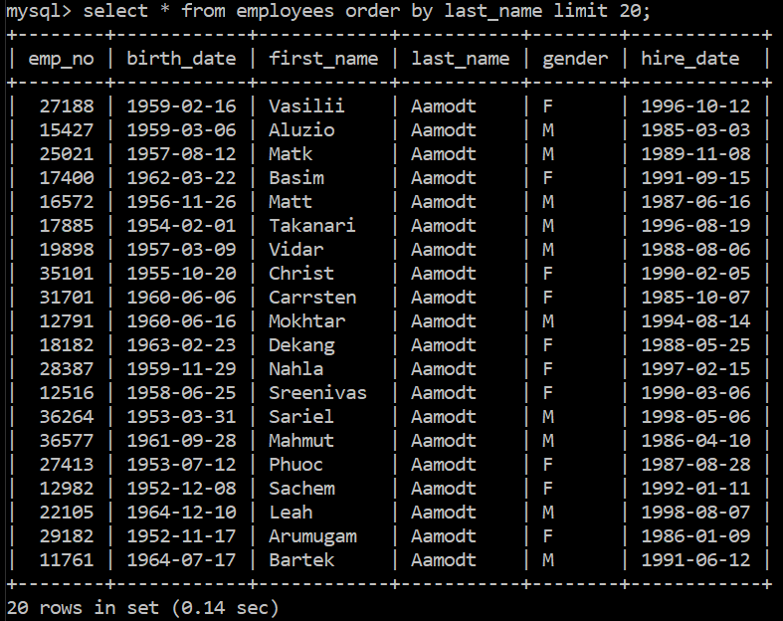
Client: MySQL CLI
Very basic interface
User unfriendly
Does not autofill
It's ugly!

Slide 19
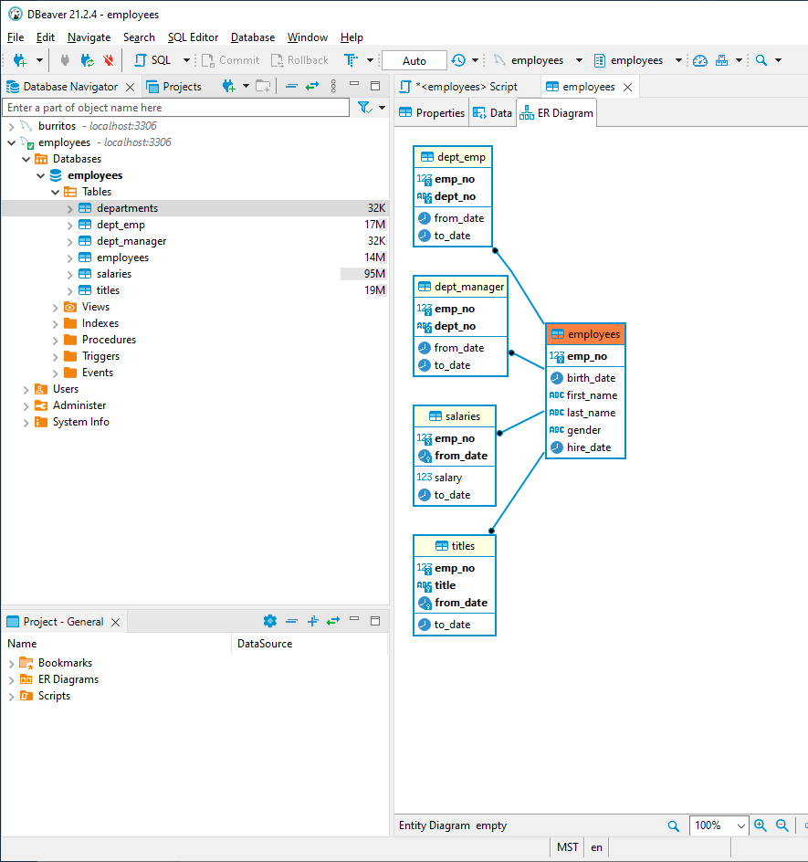
DBeaver
Queries tables automatically
Generates INSERT statements automatically
Generated ERDs automatically
Limits data returned automatically
Has intuitive graphical interface

Slide 20

Installations

Slide 21
Install MySQL Community Edition
See instructions in the resources section
Install only these components:
MySQL Community Server 8.0.x (64-bit)
MySQL Workbench 8.0.x (64-bit)

Slide 22
Install DBeaver
See instructions in resources

